Slide 1

Spam Filter: Classification Algorithm
Using an Artificial Neural Network

Slide 2
Artificial Neural Networks
SPAM!
54 Feature Inputs

Slide 3
Neural Network Workings
Forward Propagation
Cost function
Backward Propagation

Slide 4
1
Forward Propagation

Slide 5

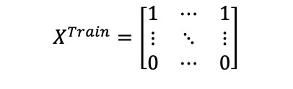

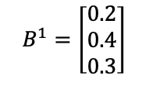
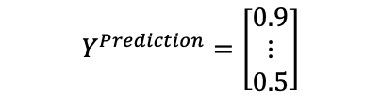


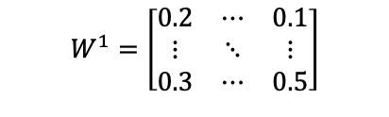

Forward Propagation
$$B^{1}=\left[\begin{matrix}0.2 \\ 0.4 \\ 0.3\end{matrix}\right]$$
$$B^{2}=\left[0.5\right]$$
$$Y^{Prediction}=\left[\begin{matrix}0.9 \\ ⋮ \\ 0.5\end{matrix}\right]$$
54 Feature Inputs
$$W^{2}=\left[\begin{matrix}0.1 & 0.2 & 0.3\end{matrix}\right]$$
$$X^{Train}=\left[\begin{matrix}1 & ⋯ & 1 \\ ⋮ & ⋱ & ⋮ \\ 0 & ⋯ & 0\end{matrix}\right]$$
$$W^{1}=\left[\begin{matrix}0.2 & ⋯ & 0.1 \\ ⋮ & ⋱ & ⋮ \\ 0.3 & ⋯ & 0.5\end{matrix}\right]$$
$$A^{1}=f(X^{Train}∙W^{1}+B^{1})$$
$$Y^{Prediction}=f(A^{1}∙W^{2}+B^{2})$$
$$f(x)=\frac{1}{1+e^{−x}}$$
Y prediction is an example, not the actual result from forward propagation with these values

Slide 6
2
Cost Function

Slide 7
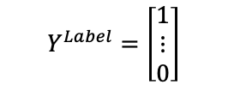
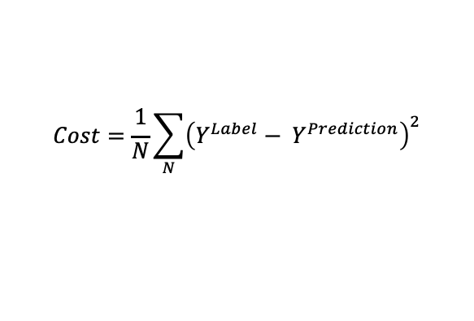
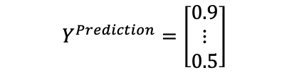
Cost Function
$$Y^{Prediction}=\left[\begin{matrix}0.9 \\ ⋮ \\ 0.5\end{matrix}\right]$$
$$Y^{Label}=\left[\begin{matrix}1 \\ ⋮ \\ 0\end{matrix}\right]$$
$$Cost=\frac{1}{N}\sum_{N}{{\left({Y^{Label}− Y}^{Prediction}\right)}^{2}}$$

Slide 8
3
Backward Propagation

Slide 9
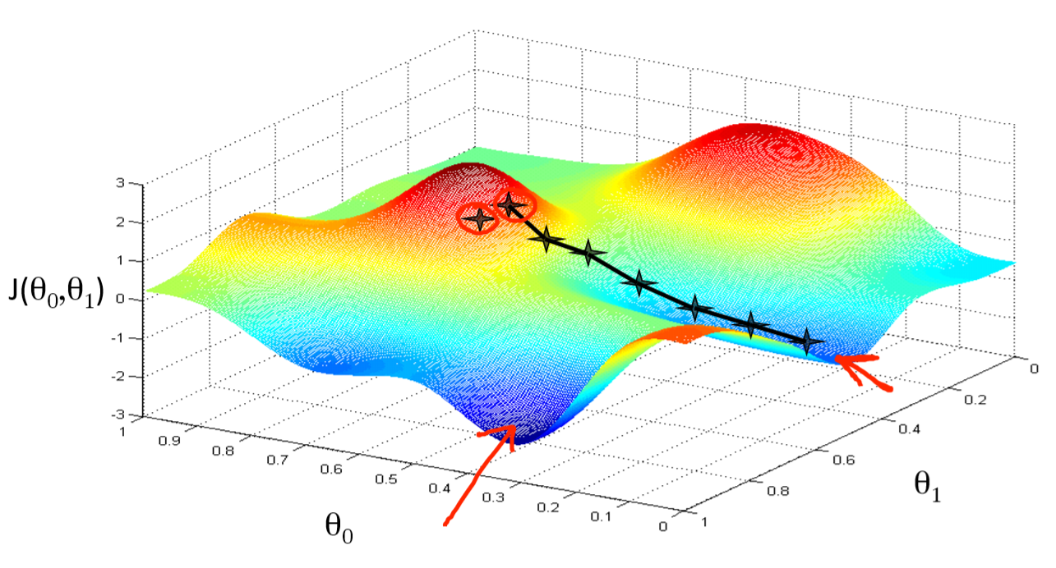
Gradient Descent
https://medium.com/hackernoon/gradient-descent-aynk-7cbe95a778da

Slide 10






Backward Propagation
$$\frac{∂Cost}{∂Y}=2(Y^{Label}−Y^{Prediction})$$
$$\frac{∂Cost}{∂A^{1}}=\frac{∂Z^{2}}{∂A^{1}} \frac{∂Y}{∂Z^{2}} \frac{∂Cost}{∂Y}$$
$$\frac{∂Cost}{∂W^{2}}=\frac{∂Z^{2}}{∂W^{2}}\frac{∂Y}{∂Z^{2}}\frac{∂Cost}{∂A^{2}}$$
$$\frac{∂Cost}{∂B^{2}}=\frac{∂Z^{2}}{∂B^{2}}\frac{∂Y}{∂Z^{2}}\frac{∂Cost}{∂A^{2}}$$
$$\frac{∂Cost}{∂W^{1}}=\frac{∂Z^{1}}{∂W^{1}} \frac{∂A^{1}}{∂Z^{1}} \frac{∂Cost}{∂A^{1}}$$
$$\frac{∂Cost}{∂B^{1}}=\frac{∂Z^{1}}{∂B^{1}} \frac{∂A^{1}}{∂Z^{1}} \frac{∂Cost}{∂A^{1}}$$

Slide 11
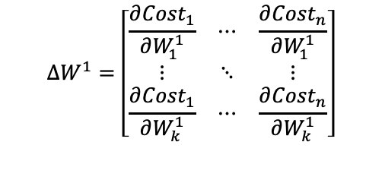
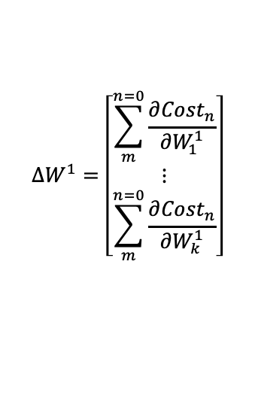
Backward Propagation
$$∆W^{1}=\left[\begin{matrix}\sum_{m}^{n=0}{\frac{∂{Cost}_{n}}{∂W_{1}^{1}}} \\ ⋮ \\ \sum_{m}^{n=0}{\frac{∂{Cost}_{n}}{∂W_{k}^{1}}}\end{matrix}\right]$$
$$∆W^{1}=\left[\begin{matrix}\frac{∂{Cost}_{1}}{∂W_{1}^{1}} & ⋯ & \frac{∂{Cost}_{n}}{∂W_{1}^{1}} \\ ⋮ & ⋱ & ⋮ \\ \frac{∂{Cost}_{1}}{∂W_{k}^{1}} & ⋯ & \frac{∂{Cost}_{n}}{∂W_{k}^{1}}\end{matrix}\right]$$
$$W^{1}=W^{1}−∆W^{1}× learning rate$$

Slide 12
Result

Slide 13
A Not bad Classifier!
ANN with one hidden layer (of 3 nodes) was trained over 5000 epochs with two batches of 500 training examples in each epoch
This ANN produced a set of weights and biases that could predict to an accuracy of 92.6% on the testing data set
There seems to be a method that drops some edges from the graph that can produce a graph that generalises better to testing data – this would be an interesting thing to investigate

Slide 14
Thanks

